Slide 1
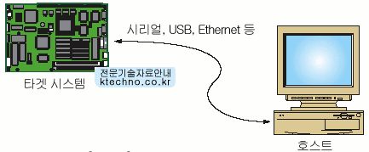
PWM_Fan_Controller_F429ZI
Nucleo-F429ZI 핀맵

Slide 2
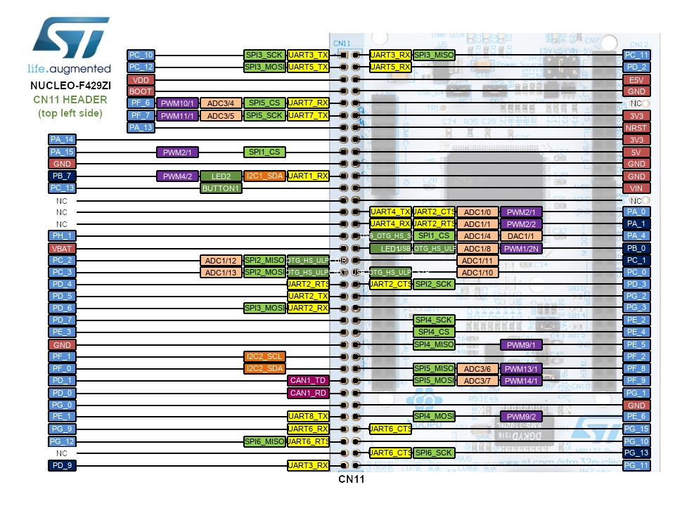
**
SEG_SPI3_SCK
1
1
SEG_SPI3_MISO
SEG_SPI3_MOSI
INPUT_DP1
LED_PSU_R
5
5
LED_PSU_G
SWDIO
SWCLK
SEG_LOAD
10
10
LD2_BLU
USER_Btn
TIM2_CH1_IC1
15
15
ETH_REF_CLK
SEG_nOE
LD1_GRN
ETH_MDC
TEST_BTN
INPUT_DP3
20
20
INPUT_DP2
INPUT_CHG
SEG1_C
SEG1_D
SEG2_A
25
25
SEG2_B
LED_TEMP_G
LED_FAN1_R
LED_TEMP_R
LED_DP1_G
INPUT_PSU2
LED_DP2_G
INPUT_PSU1
30
30
SEG2_C
SEG1_B
ETH_TXD0
USART3_STL_RX
35
35
ETH_TX_EN

Slide 3
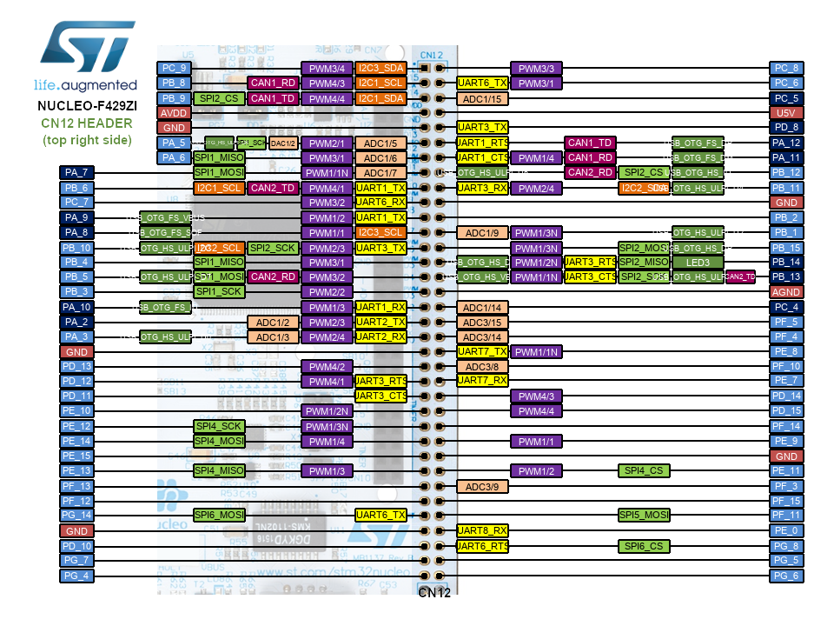
**
Buzzer_Off();
BAT_I2C3_SDA
1
1
TIM3_CH3_PWM6
HTMUX_I2C1_SCL
TIM3_CH1_PWM4
HTMUX _I2C1_SDA
ETH_RXD1
5
5
USART3_STL_TX
SEG_SPI1_CLK
USB_DP
SEG_LE
USB_DM
ETH_CRS_DV
HTMUX _I2C1_RESET
TIM2_CH4_IC3
TIM3_CH2_PWM5
10
10
USB_VBUS
BAT_I2C3_SCL
TIM2_CH3_IC2
SEG_ SPI1_MISO
LD3_RED
SEG_ SPI1_MOSI
15
15
ETH_TXD1
SWO
SEG_nOE
ETH_RXD0
ETH_MDIO
LED_FAN2_G
TIM5_CH4_BUZ
LED_FAN2_R
20
20
TIM4_CH2_IC5
LED_DP3_G
TIM4_CH2_IC5
TIM4_CH1_IC4
SEG2_C
TIM4_CH3_IC6
25
25
TIM1_CH1_PWM1
TIM1_CH3_PWM3
TIM1_CH2_PWM2
LED_MineDet
LED_FAN1_G
LED_CHG_G
30
30
LED_RUN
LED_CHG_R
SEG1_A
USB_OVC
35
35
USB_PWR_SW

Slide 4
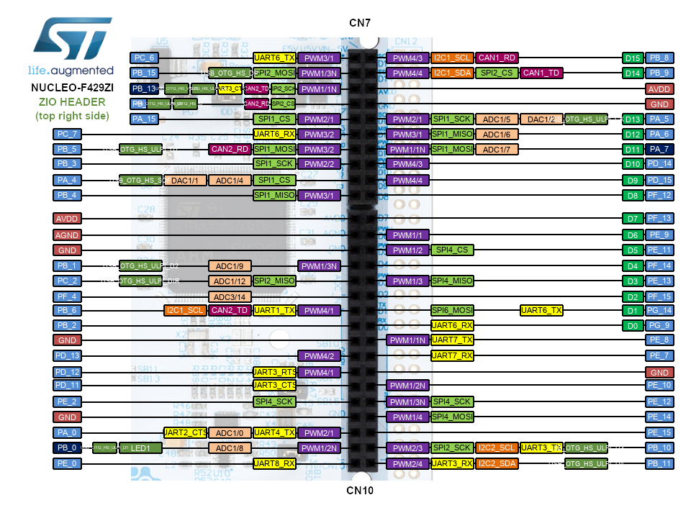
**

Slide 5
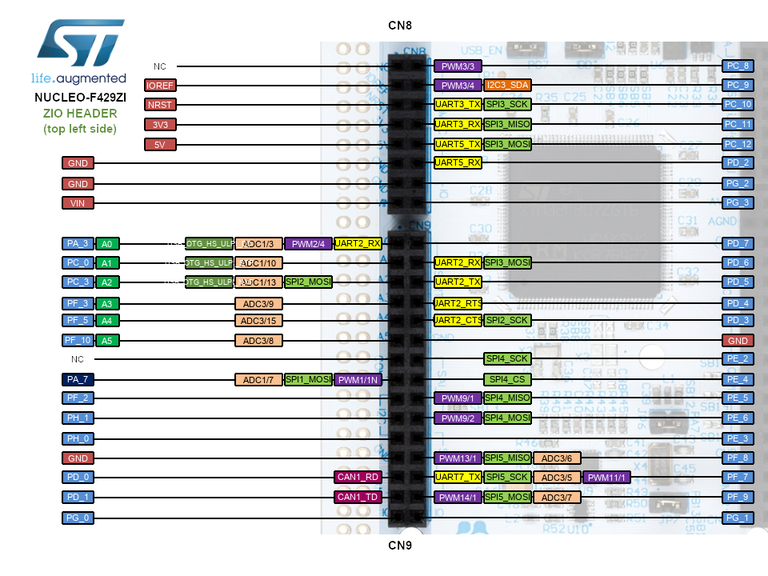
**

Slide 6
**
TEMP | FAN1 | FAN2 | PSU
TEMP | FAN1 | FAN2 | PSU
DP1 | DP2 | DP3 | CHG | BUZ
DP1 | DP2 | DP3 | CHG | BUZ
PSU1 | PSU2 | DP1 | DP2 | DP3 | CHG
PSU1 | PSU2 | DP1 | DP2 | DP3 | CHG

Slide 8


